Slide 1
Local Government, Social Media, Web Strategy Bringing the Pieces Together

Slide 2
Overview
Tripepi Smith Internet Strategy Study: Orange County
Results & Observations
5 Key Social Media Points for Cities
3 Spooky Realities

Slide 3
OC Internet Strategy Study
Part I

Slide 4
Internet Strategy Study Methodology
Focus On Simple Yes/No Questions
Social Media
Website Features
Elected Connectivity & Email Response
34 Cities in Orange County Only
Used a Point Weighting System to Subtotal Cities
Did Not Publish Rankings to Avoid Comparisons
Invited Surveyed Cities to Request Detailed Results

Slide 5
Highlighted Findings
Top Scoring Cities
Newport Beach, Tustin, Dana Point, Brea, Buena Park & Fullerton
29 of 34 Cities had email for mayor or council on their websites (forms don’t count)
18 of 34 Cities had online council meeting video (Granicus)
27 of 34 Cities had a friendly URL (cityofirvine.org v. www.ci.seal-beach.ca.us)

Slide 6
Highlighted Findings
21 of 34 Cities have Twitter Accounts
10,700+ Followers (includes duplicates)
8,209 Tweets
14 of 21 Tweeted in last 7 days
17 of 34 Cities have Facebook Pages
18,723 “Likes” of those Pages
12 of 17 Updated in Last 7 Days
9 of 17 have Vanity URL’s (facebook.com/cityoftustin)

Slide 7
Highlighted Findings
Study Available for Download:
http://www.tripepismith.com/articles/

Slide 8
5 key Social media Points for Cities
Part II

Slide 9
Secure Your Brand
Feature Official social media links on website home page
Create a web page dedicated to social media
Outline different social media channels, if applicable: City, Parks and Rec., Police Department
Optimize your logo/seal for Twitter and Facebook
Note thumbnail versus regular logo image sizes
Secure a Vanity URL for Facebook Page
Match your Twitter account to Friendly Domain Name

Slide 10
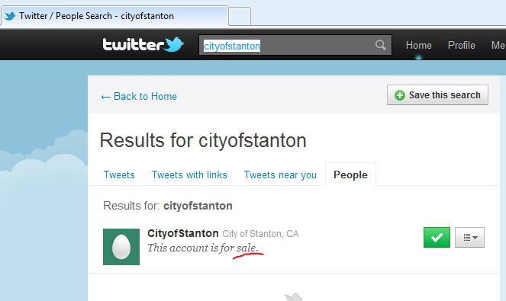
Twitter Name Squatting

Slide 11
Engage The Public
Follow other influential organizations
Don’t just broadcast… listen
Following others usually results in them following you
Setup key word searches and hash tags
Focus content on city related matters
Avoid spamming the public
Update no less than every seven days

Slide 12
Leverage Tools
Popular tools include: TweetDeck, HootSuite, CoTweet
Allow more than one person to handle broadcasts and general social media responsibilities
Provides monitoring options and multi-account monitoring through a single interface
Some include mobile options for PIO’s that are 24/7

Slide 13
Know Social Media’s Limits
Facebook and Twitter are huge, but not ubiquitous
150,000,000 US Facebook Users
75,000,000 Twitter Accounts Worldwide (many are inactive)
Lot’s of people are not using social media
Good old websites still need to be used
Don’t expect to stop placing content on your website

Slide 14
Track Your Influence
The Internet delivers a rich set of data on your digital presence.
Review your website stats
Leverage Google Analytics or equivalent
Facebook Pages features Insights
Track your mentions and re-tweets on Twitter

Slide 15
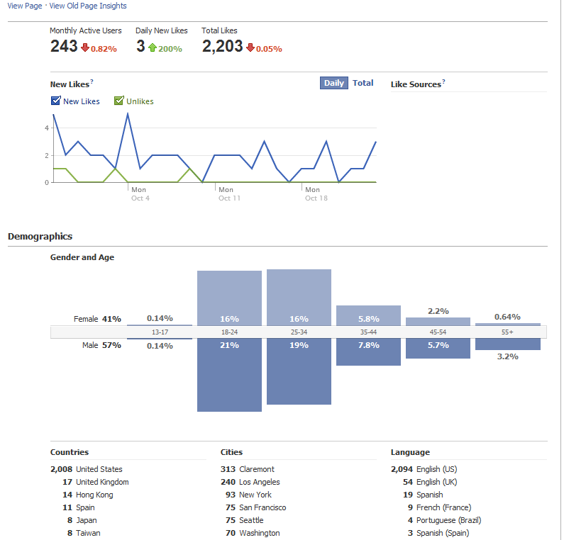

Slide 16
3 spooky realities
Part III

Slide 17
You Are Not In Control
You operate in their world and are subject to their rules.
Example: Twitter Redesign Kills Custom Backgrounds

Slide 18
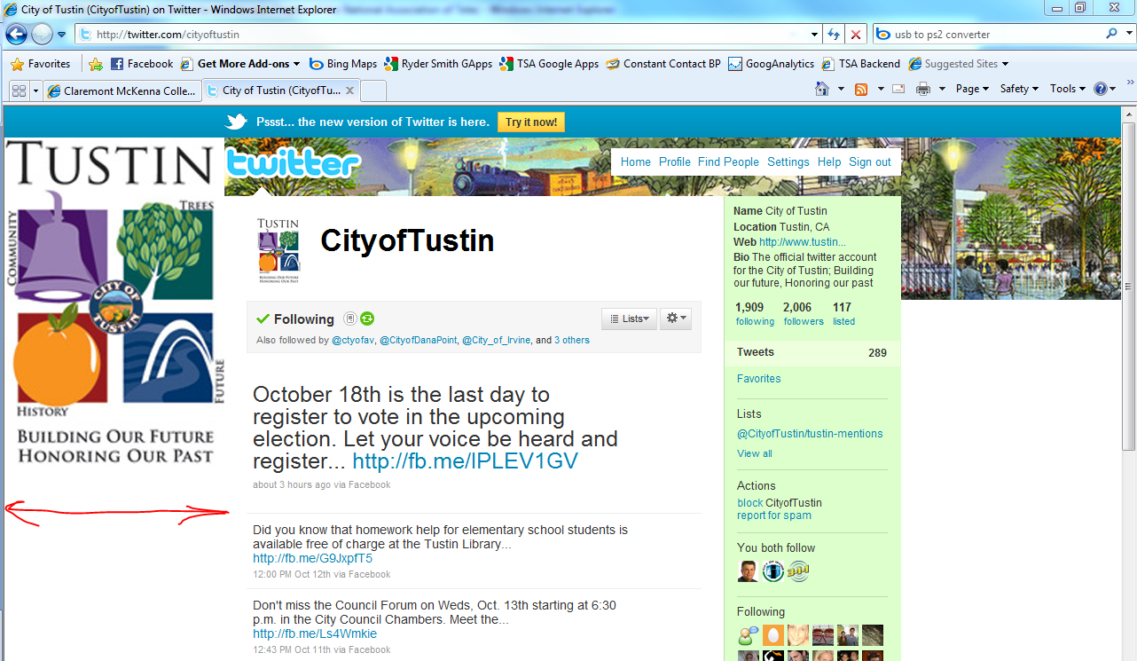

Slide 19
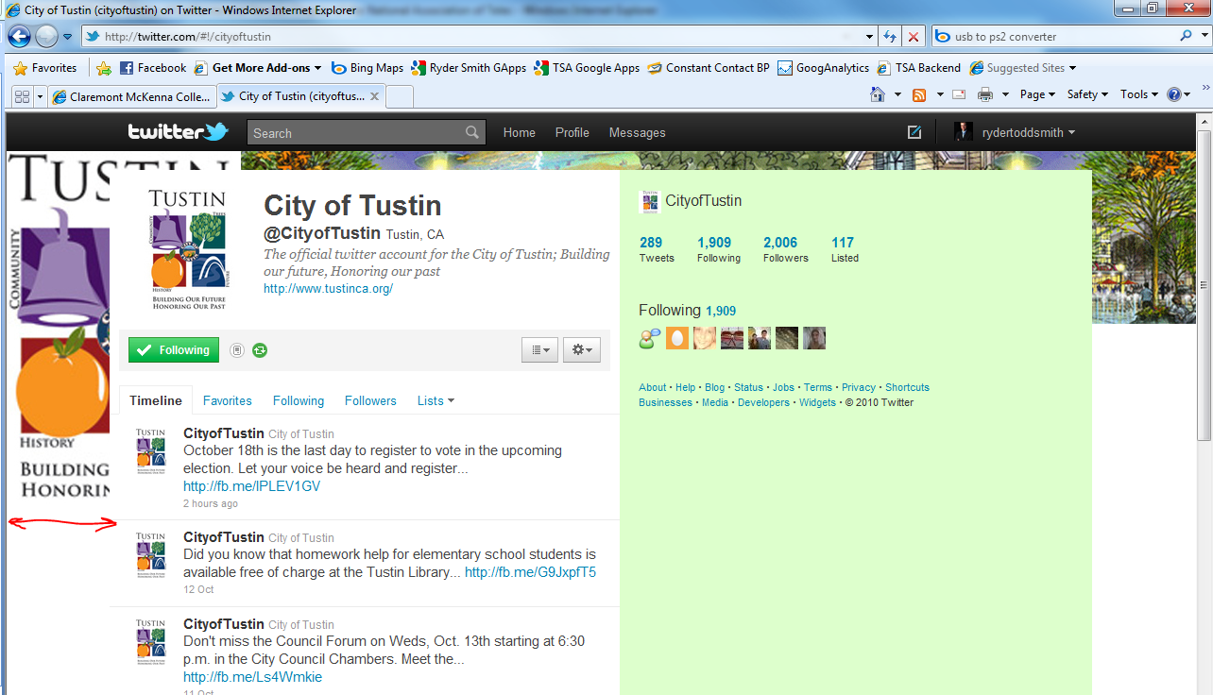

Slide 20
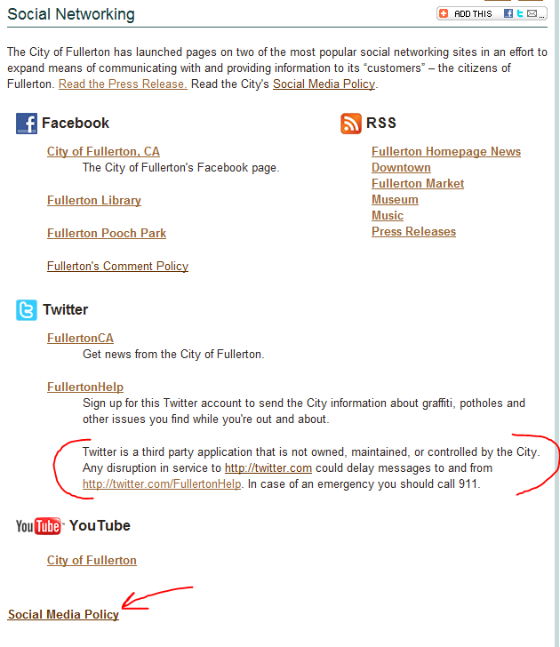
Privacy is a Concern
Clearly state risks and note third party nature of these tools, even if it seems obvious.
“The city made me do it.”

Slide 21
Everyone Has a Soapbox
Social Media is bi-directional and does not require a license
City gadflies/critics/aspiring candidates can engage cities very publicly on the city’s turf
Followers of cities on Twitter and Facebook are more likely to be highly engaged citizen (i.e. they vote or have regular contact with elected officials)
Strong, clearly stated social media policies should be in place prior to embarking on an active social media effort
However, securing ID’s and branding can precede the policy (time is of the essence)

Slide 22
Things You Must Remember
Secure your social media identity or someone else will
The social media tools and capabilities are changing rapidly so you will need to review your strategy/efforts on a quarterly basis
Social media is about society. It appeals to the natural instincts of people to communicate, interact and engage, only it makes this process 100x faster and easier to do

Slide 23
Contact Information
ryder@tripepismith.com
twitter.com/tripepismith
facebook.com/tripepismith
linkedin.com/in/rydertoddsmith

