Slide 1
Local Regulation of Small Cells and Other Wireless Facilities
Michael W. Shonafelt
SCAN NATOA
February 13, 2020

Slide 2
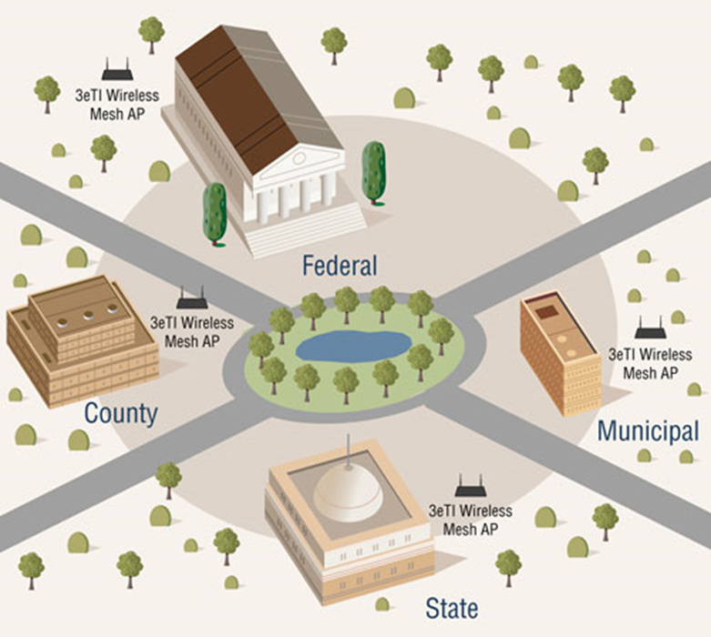
Backdrop

Slide 3
Land Use Basics for Wireless
As a general rule, land use law is the purview of local government (cities and counties).
The federal government generally cannot intervene in matters given to the local police power.

Slide 4
Competing Interests
Interests of the Wireless Industry:
Fourfold increase in wireless data traffic from 2014 to 2017
The number of smartphones increased by 31 percent from 2014 to 2017
Smartphone ownership increased from 35 to 77 percent from 2011 to 2017

Slide 5
Competing Interests
50 PERCENT of American households have dropped their landlines and are wholly dependent on wireless devices for communication.
75 PERCENT of all 911 calls are made on wireless devices.
15TH IN THE WORLD: the United States dropped to fifteenth in the world in wireless broadband penetration, well behind South Korea, Japan, the Netherlands, and France.

Slide 6
Competing Interests
Data demand from new smart phones and tablets is leading to a critical deficit in spectrum, requiring more wireless antennas and infrastructure.

Slide 7
Competing Interests
The Interests of local government:
Effective land use planning
Aesthetic impacts
Health, safety and welfare

Slide 8
Competing Interests
The concept of the public welfare is broad and inclusive … The values it represents are spiritual as well as physical, aesthetic as well as monetary. It is within the power of the legislature to determine that the community should be beautiful as well as healthy, spacious as well as clean, well balanced as well as carefully patrolled.”
-Justice William O. Douglass, Berman v. Parker (1954).

Slide 9
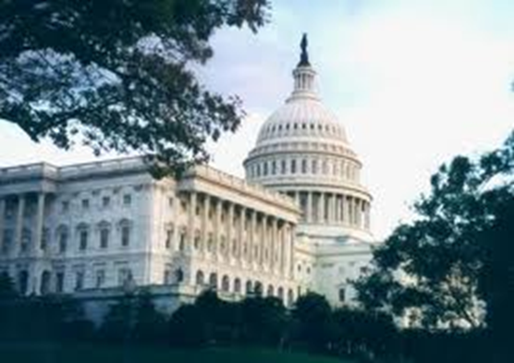
The Federal Interest
In the case of wireless telecommunications, however, federal interests come into play.
Congress enacted the Telecommunications Act of 1996, in part, to address those interests.

Slide 10
The Federal Interest
“Congress reaffirmed its commitment to nationwide telecommunications and cellular service when it passed the TCA in 1996. It announced its intent ‘to promote competition and reduce regulation in order to secure lower prices and higher quality services for American telecommunications consumers and encourage the rapid deployment of new telecommunications technologies.’”
- Ninth Circuit Court of Appeals, Sprint Telephony PCS, L.P. v. County of San Diego (2007)

Slide 11
Substantial Evidence Requirement
Denials must be supported by substantial evidence. (47 U.S.C. § 332(c)(7)(B)(iii))

Slide 12
Prohibition Against Unreasonable Discrimination
Agencies cannot “unreasonably discriminate” among providers of “functionally equivalent services.” (47 U.S.C. § 332(c)(7)(B)(i)(I).)

Slide 13
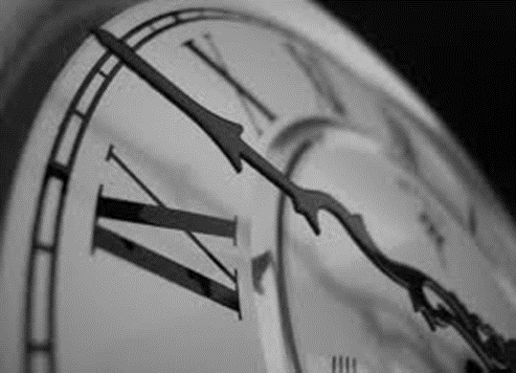
Reasonable Period of Time Requirement
State and local governments must act on applications within a reasonable period of time after the request is duly filed. (47 U.S.C. § 332(c)(7)(B).)

Slide 14
Reasonable Period of Time Requirement
In 2009, 3,300 permit applications for wireless telecommunications facilities were languishing in city and county planning departments. 760 of those had been pending for more than a year.

Slide 15
Prohibition of Services
Agencies cannot prohibit the provision of personal wireless services. (47 U.S.C. § 332(c)(7)(B)(i)(II) .)

Slide 16
RF Emissions
State and local governments cannot regulate the placement, construction, and modification of wireless facilities on the basis of the environmental effects of RF emissions. (47 U.S.C. § 332(c)(7)(B).)

Slide 17
Right to Judicial Relief
Any person adversely affected by any final action or failure to act by a state or local government may bring a court action within 30 days. The court shall hear and decide such action on an expedited basis. (47 U.S.C. § 332(c)(7)(B).)

Slide 18
Other Federal Provisions: Spectrum Act
Located in Section 6409 of the “Middle Class Tax Relief and Job Creation Act of 2012” (See 47 U.S.C. § 1455)
“[A] State or local government may not deny, and shall approve, any eligible facilities request for a modification of an existing wireless tower or base station that does not substantially change the physical dimensions of such tower or base station.” (Emphasis added.)

Slide 19
The Spectrum Act
Section 6409 is intended to “promote the deployment of wireless infrastructure” by “eliminating unnecessary reviews” associated with facility siting. (In the Matter of Acceleration of Broadband Deployment by Improving Facilities Siting Policies (FCC, Oct. 17, 2014), at p. 2.)

Slide 20
The FCC Small Cell Order
Shortened shot clocks from 150 days to 90 days for new facilities, and from 90 to 60 days for collocations
Failure to act within the Shot Clock timeframe now amounts to a presumptive prohibition of service in violation of the Telecom Act.
Adopted the “materially inhibit” standard articulated in the FCC’s 1997 California Payphone decision.
A state or local law now has the effect of prohibiting the provision of telecommunications service if it “materially inhibits or limits the ability of any competitor or potential competitor to compete in a fair and balanced legal and regulatory environment.”

Slide 21
The FCC Small Cell Order
A state or local law now has the effect of prohibiting the provision of telecommunications service if it “materially inhibits or limits the ability of any competitor or potential competitor to compete in a fair and balanced legal and regulatory environment.”
Requires aesthetic requirements to be (a) reasonable; (b) no more burdensome than those applied to other types of infrastructure deployments, and (c) objective and published in advance

Slide 22
The FCC Small Cell Order
A local jurisdiction’s fees violate Section 253 unless the following three conditions are met:
(1) The fees are a reasonable approximation of the state or local government’s costs;
(2) Only objectively reasonable costs are factored into those fees; and
(3) The fees are no higher than the fees charged to similarly-situated competitors in similar situations.

Slide 23
Public Utilities Code Section 7901
“Telegraph or telephone corporations may construct lines of telegraph or telephone lines along and upon any public road or highway, along or across any of the waters or lands within this State, and may erect poles, posts, piers, or abutments for supporting the insulators, wires, and other necessary fixtures of their lines, in such manner and at such points as not to incommode the public use of the road or highway or interrupt the navigation of the waters.”

Slide 24
Public Rights-of-Way
Adoption of Civil Code section 536

Slide 25
Public Utilities Code Section 7901.1
Municipalities “shall have the right to exercise reasonable control as to the time, place, and manner in which roads, highways, and waterways are accessed.”
“The control, to be reasonable, shall, at a minimum, be applied to all entities in an equivalent manner.”

Slide 26
Public Utilities Code Section 7901
Followed old federal Post Roads Act

Slide 27
Constraints on Fees: Government Code Section 50030
Any permit fee imposed by a city… or a city and county, for the placement, installation, repair, or upgrading of telecommunications facilities such as lines, poles, or antennas by a telephone corporation … shall not exceed the reasonable costs of providing the service for which the fee is charged and shall not be levied for general revenue purposes.

Slide 28
Approval by Law: Government Code Section 65964.1.
If a local government fails to act on an application for a permit to construct a wireless telecommunications facility within the prescribed Shot Clock timeframes the application is deemed approved by operation of law.

Slide 29
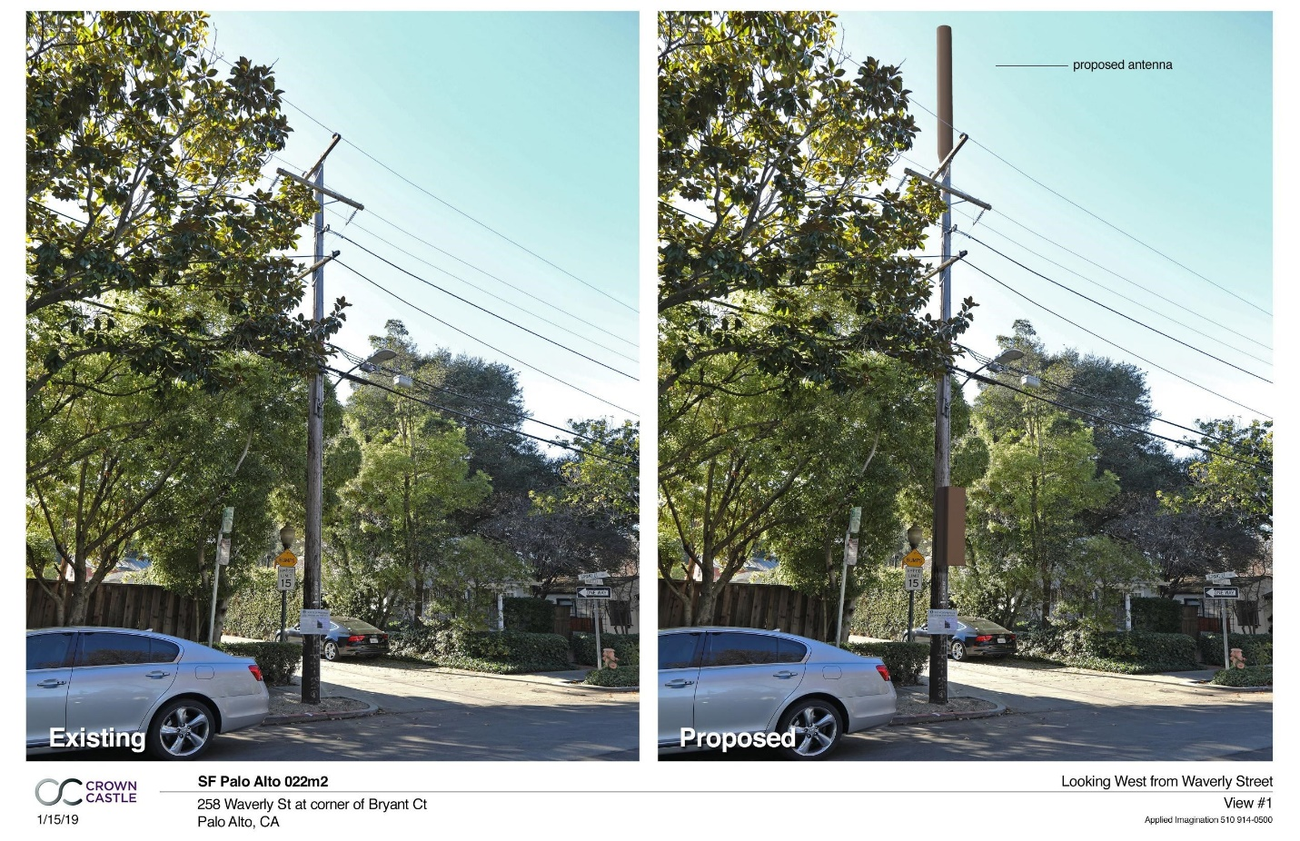
Case Study: City of Palo Alto

Slide 30
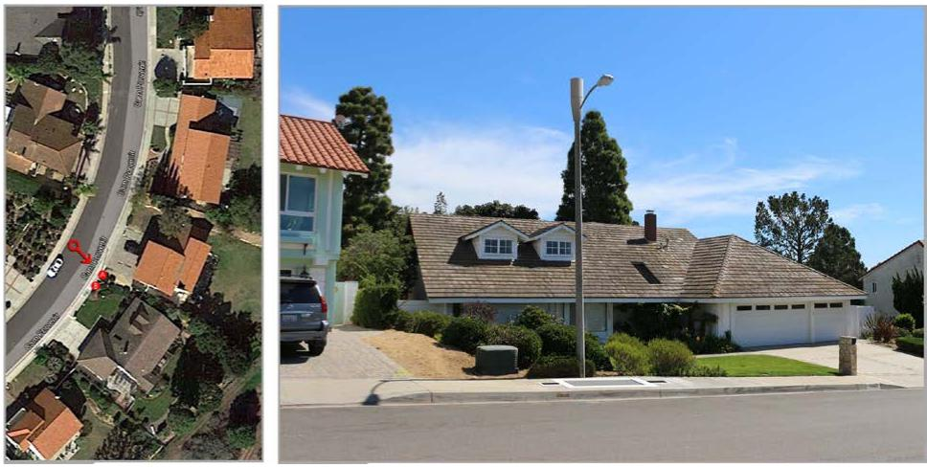
Case Study: City of Rancho Palos Verdes

Slide 31
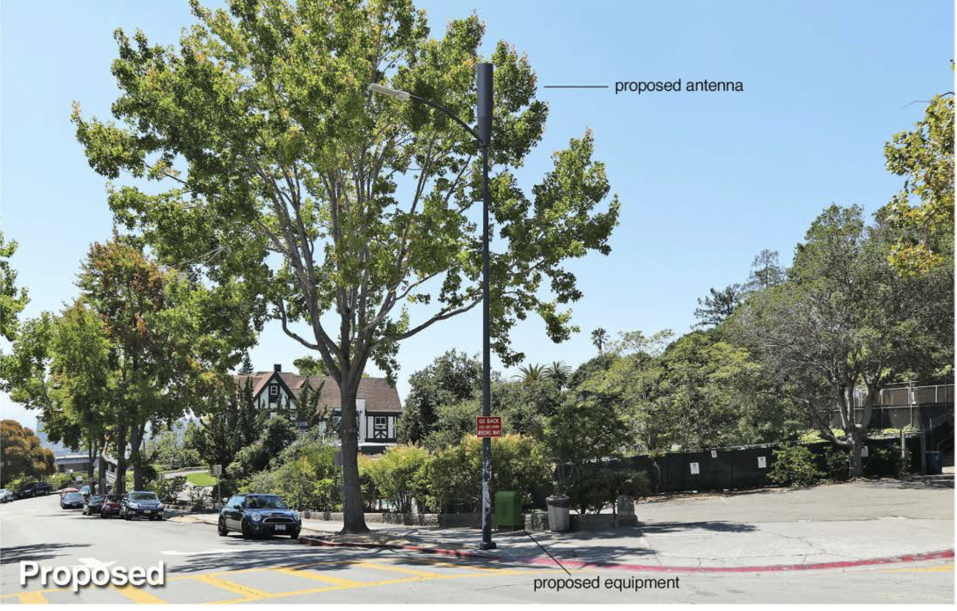
Case Study: City of Piedmont

Slide 32
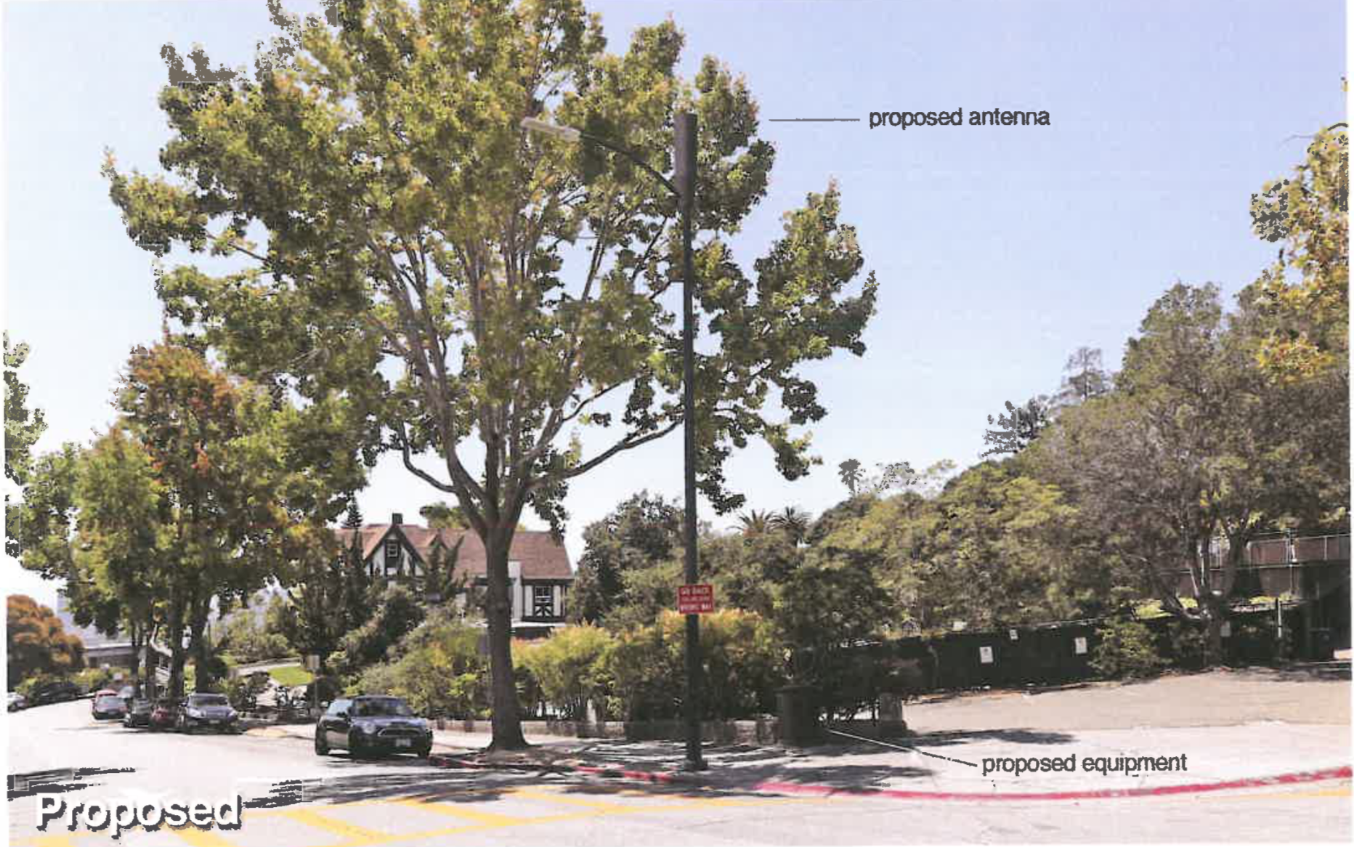
Case Study: City of Piedmont

Slide 33
Questions?

